Slide 1
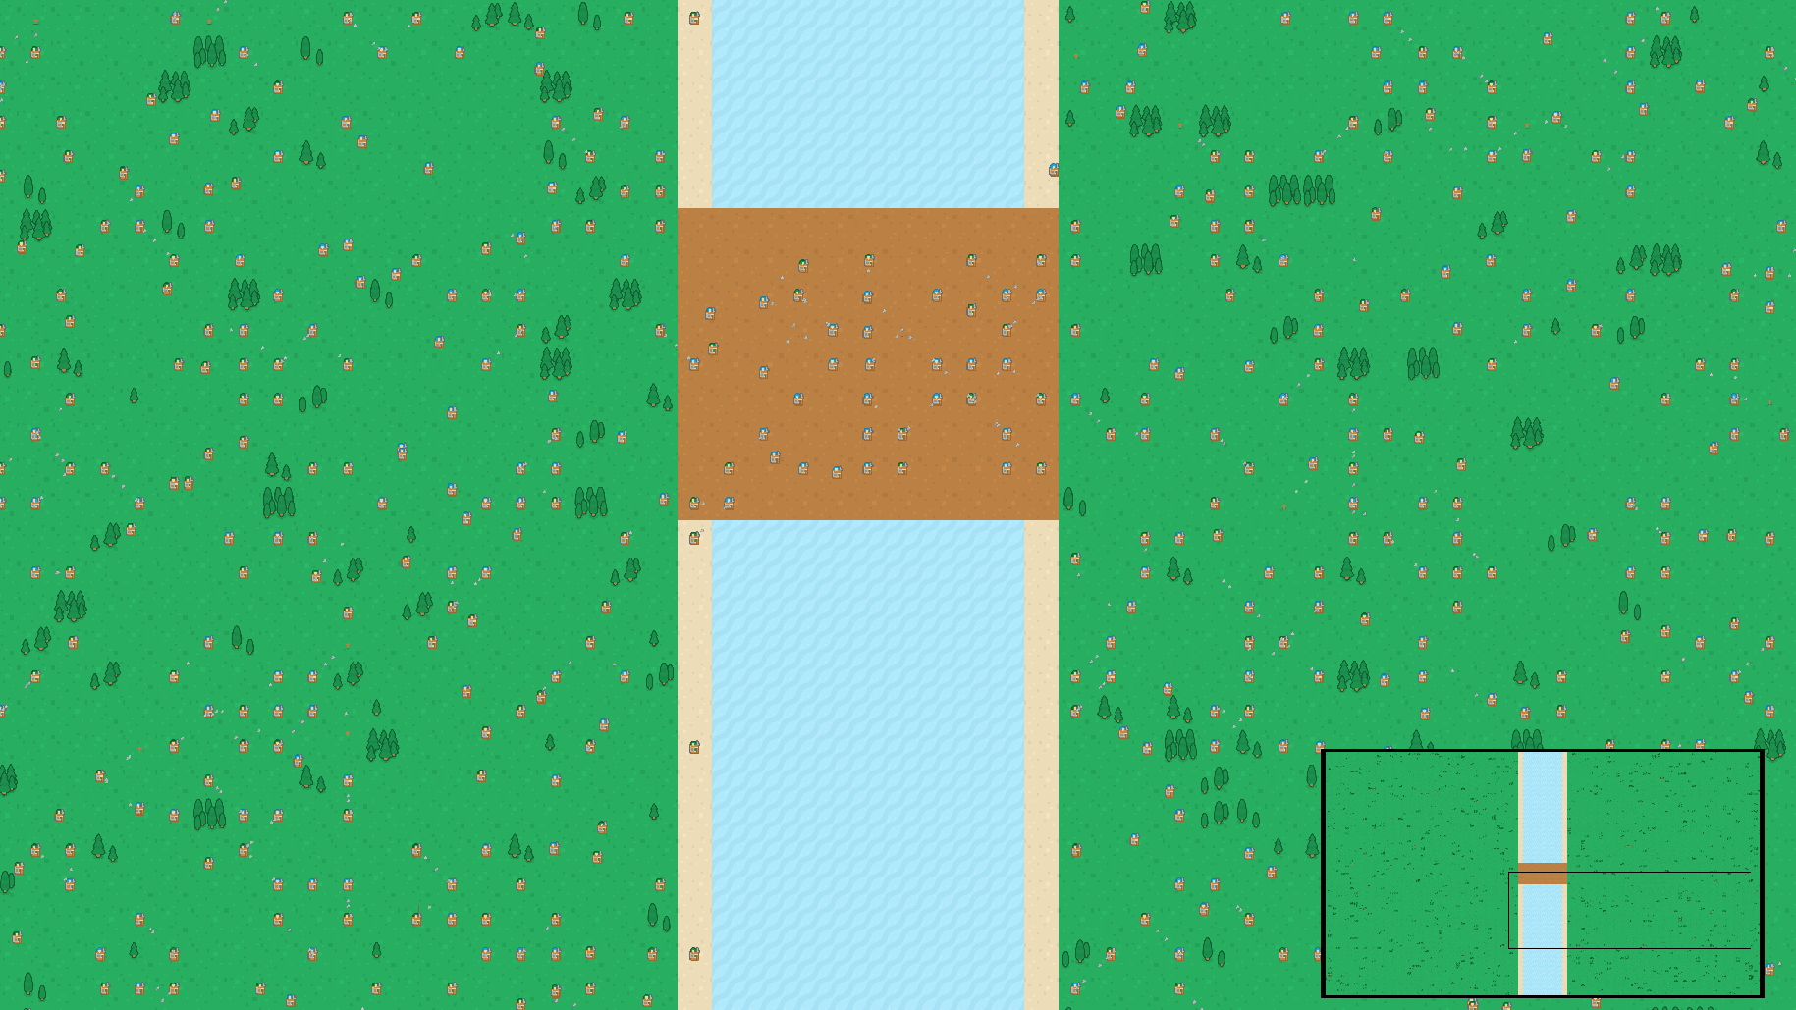
CMP202 – Data and Algorithms 2 Multi-threaded Battle Simulator
James McAdam (0702207)
02/05/18

Slide 2
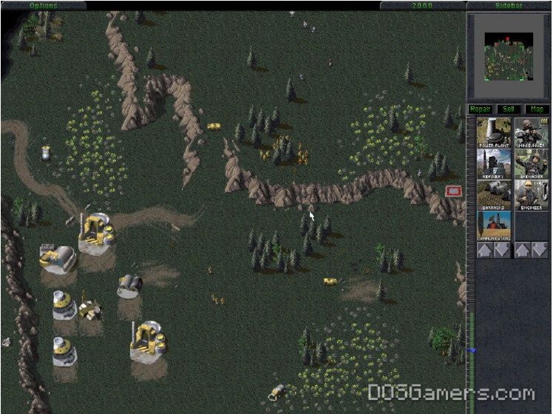
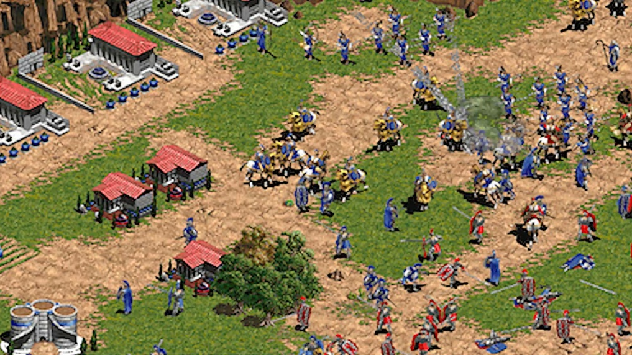
Application Purpose
Create a game style simulation of a medieval battle.
Inspired by the AI of games such as:
Command and Conquer
Age of Empires

Slide 3
Problem
Path finding using A* star.
State based AI.
Mass numbers of Units/Projectiles.
Rendering Map, Units and Projectiles.
Users can move the view around the map.
Uses SFML for rendering and Windows context.
Uses rapidXML for sprite sheet loading.

Slide 4
Application Structure and Threads Interaction
Each frame is staged using barriers with a minimum of four threads
GameObjects and Path Finding threads numbers can be varied.
Rendering is tied to one thread – SFML/OpenGL Limitation
Main Thread
Render Thread
GameObject Threads
Path Finding Threads
Create Work List
Queue Map Tiles
Sleep
Solving Paths - Asynchronous
Process Barrier
Sleep
Sleep
Update Units States
Update Projectiles
Render Barrier
Sleep
Render All Sprites
Sleep
End Frame Barrier

Slide 5
Asynchronous Path Finding
AI states request paths with unit references, start and end locations.
The path is calculated (based on map geometry only) and returned.
AI state checks an atomic flag for when it’s path request is fulfilled.
Unit
AI State
Path Finding Module
Update
Path Request
Task List
Managed by Semaphore
Thread safe access using mutex
Path
Worker Threads Solving A* Paths

Slide 6


GameObject Updates
Object manages list of ‘live’ objects – Managed through creating task list.
Object Updates conducted via task based pattern using multiple threads.
AI Units have four state – Search and Destroy, Charge, Fight and Death.
States have thread safe access to a map to enquire about other units.

Slide 7
Rendering – One Thread
Tile Map
GameObject Update
Only data required by the renderer is floats for x,y and an int for the id.
Renderer handles loading the texture atlas and manages the textures and sprites.
Render Requests
Sprite Renderer
Tile Atlas Texture
Data Queue (id, x, y)
Sprite Vector
Apply x,y to Sprite with id
Call SFML Render
SFML RenderWindow

Slide 8
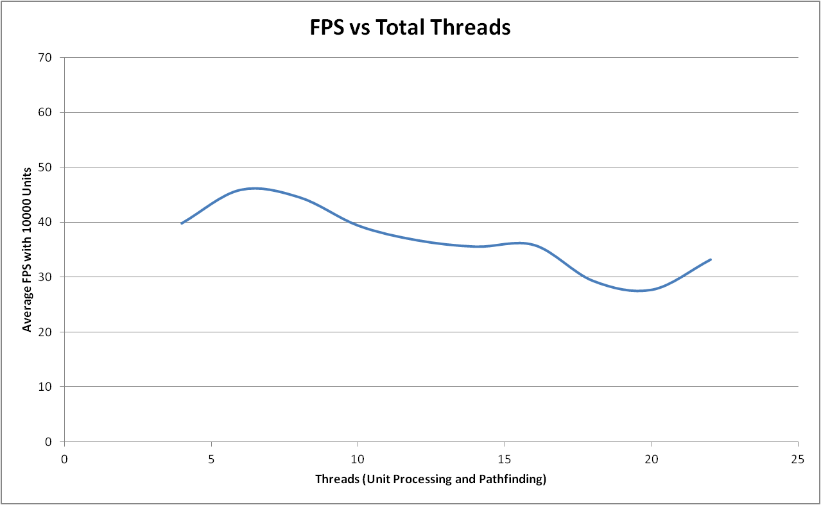
Initial Performance Assessment
Test CPU - Intel Core i7-3820 @ 3.60GHz, 4 Core(s), 8 Logical Processor(s)
6/8 threads produces optimum performance

Slide 9
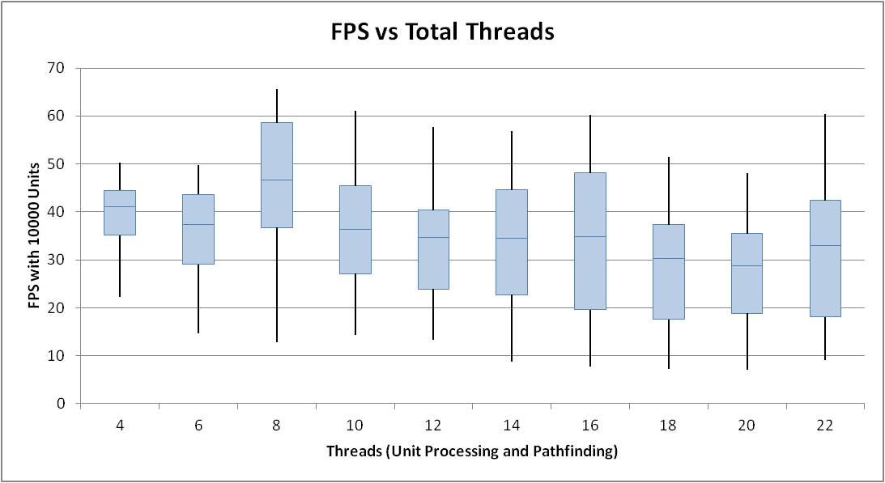
Initial Performance Assessment 2
This conclusion is comfimed looking at the box plot data.
Hence 1 main thread, 1 renedr thread and a combination of 6 pathing and update threads.

Slide 10
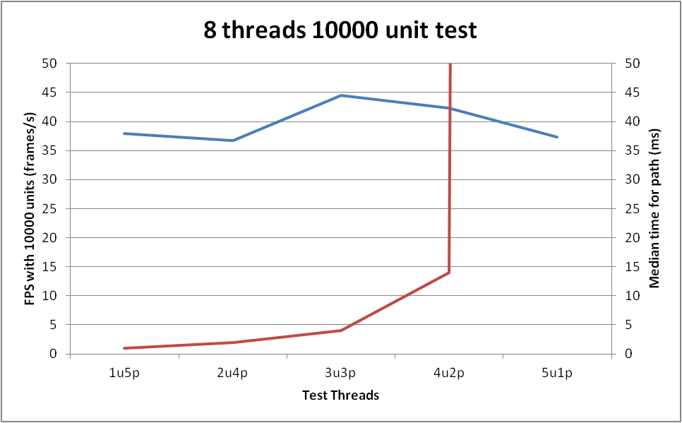
Pathing Verses FPS – The performance vs game play trade-off
Trade off between Units time to getting paths and achieveing the max possible frame rates
Significant penatlty for relying on one thread for pathfiding but not for updating units
Best Performance
Acceptable Performance
3190ms

Slide 11
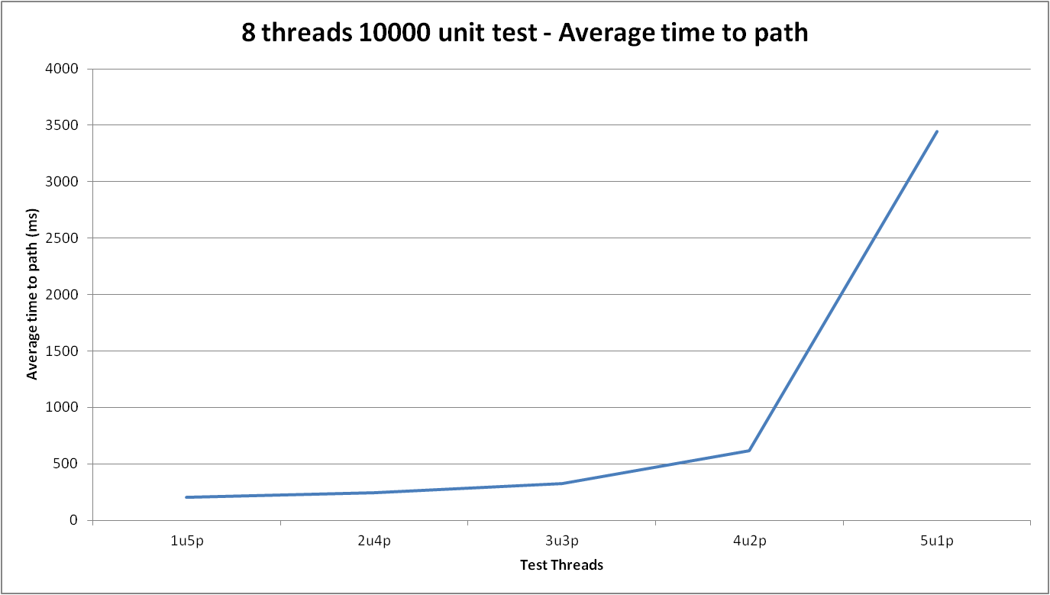
Pathing Verses FPS – The performance vs game play trade-off 2

Slide 12
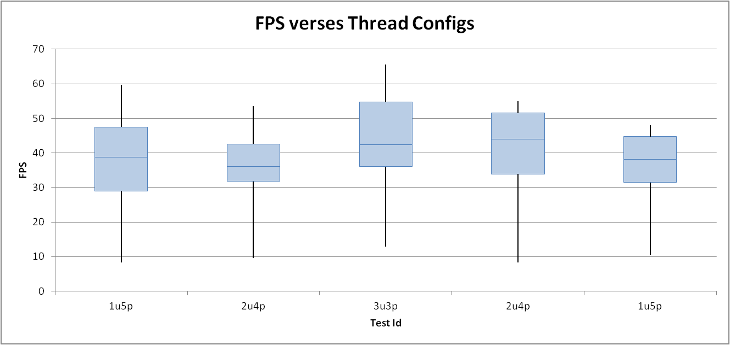
Pathing Verses FPS – The performance vs game play trade-off 3

Slide 13
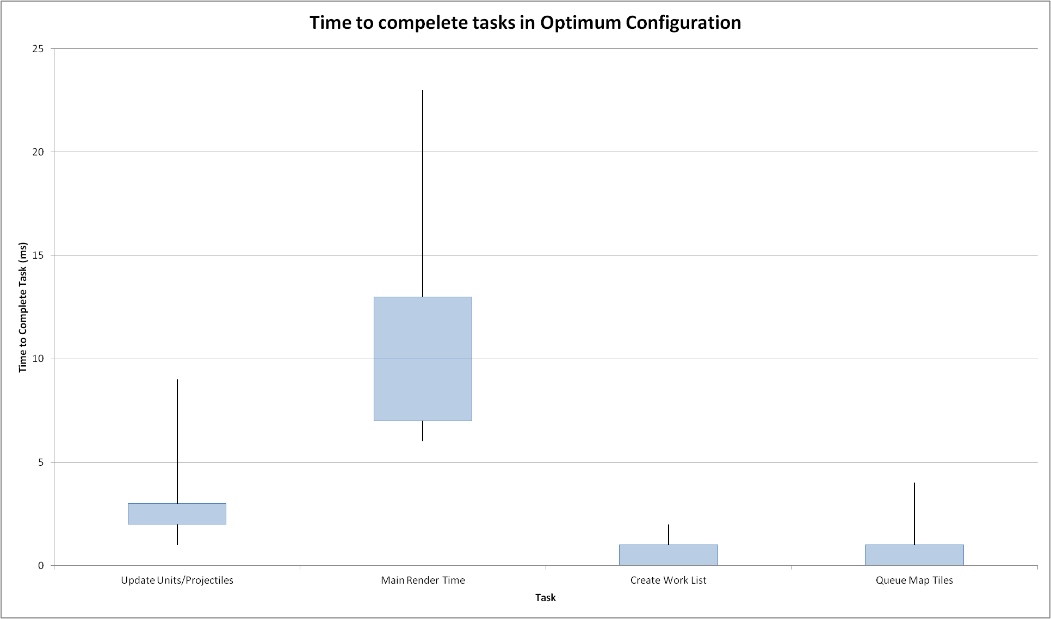
Expected Performance With Changing Unit Numbers 1
Dominant Process per Frame

Slide 14
Expected Performance With Changing Unit Numbers 2
Main Thread
Path Finding Threads
PathFind Threads have no impact on the FPS but will make units less responsive waiting on paths.
Units required listed through 3 times in containers (such as Vector or Queue) so units will impact performance by O(N)
Increasing the map dimension to accommodate units will require O(N²)
Estimate the performance will decrease by O(N²) of the map not the units which is the dominant factor as Rendering consumes the most frame time.
Render Thread
GameObject Threads
O(N_{u}+N_{p})
O(N_{T}*N_{T})
O(N_{R})
Process Barrier
O(N_{u} +N_{p})
Render Barrier
O(N_{u}+N_{p}+N_{T}*N_{T})
End Frame Barrier

Slide 15
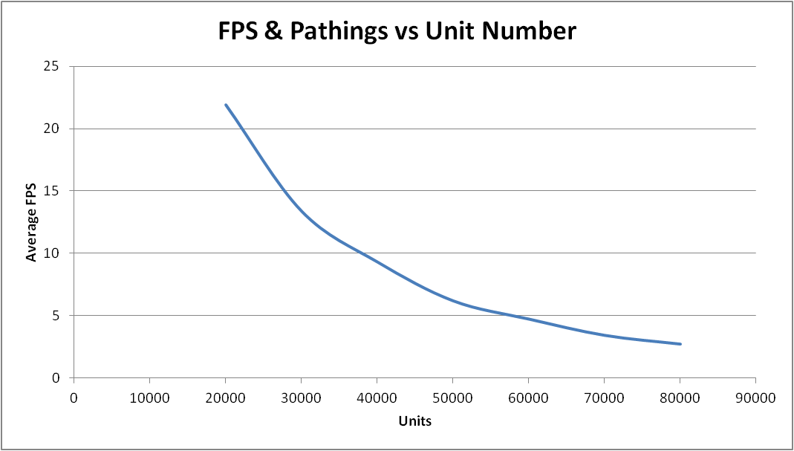
How well does this scale 2
FPS decreases at ≈O(N²)

Slide 16
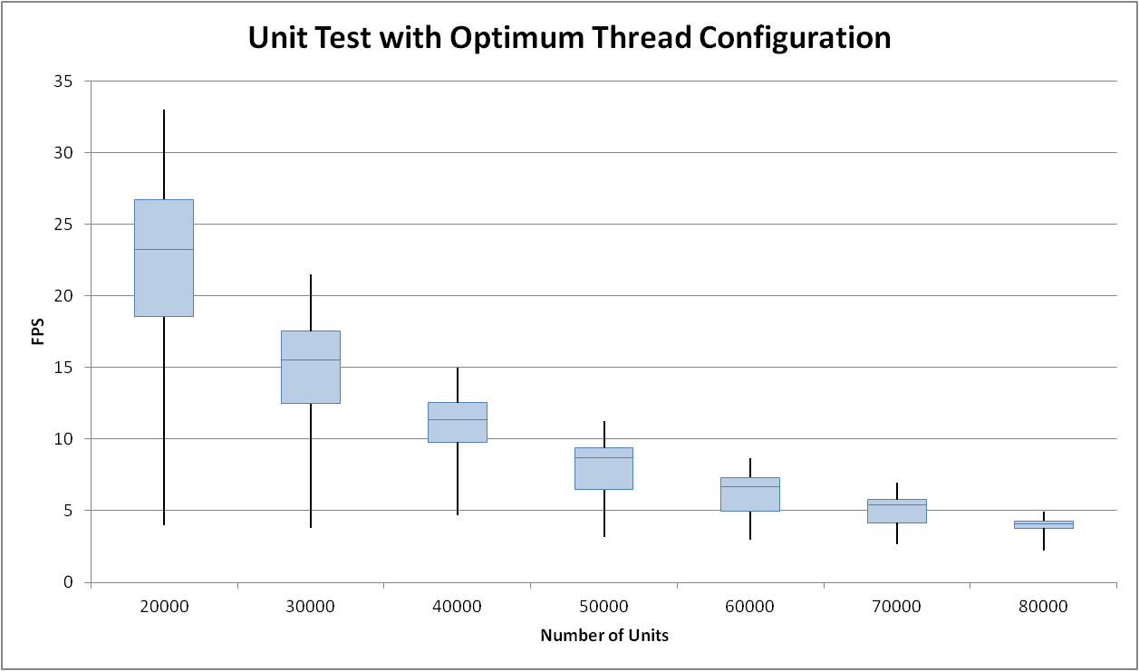
How well does this scale 2
Double map size results in ≈4 times lower FPS

Slide 17
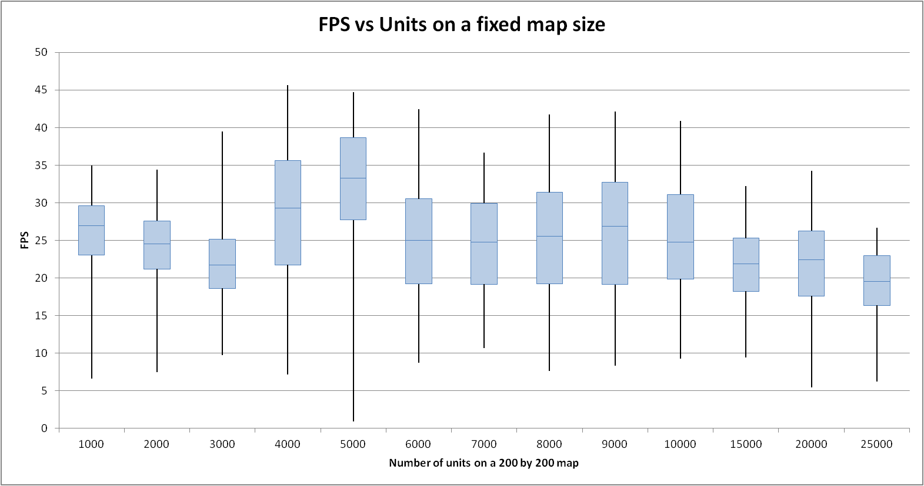
How well does this scale 3
No clear O(N) effect observed
Noise too great
Change is not statistically mearuables

Slide 18
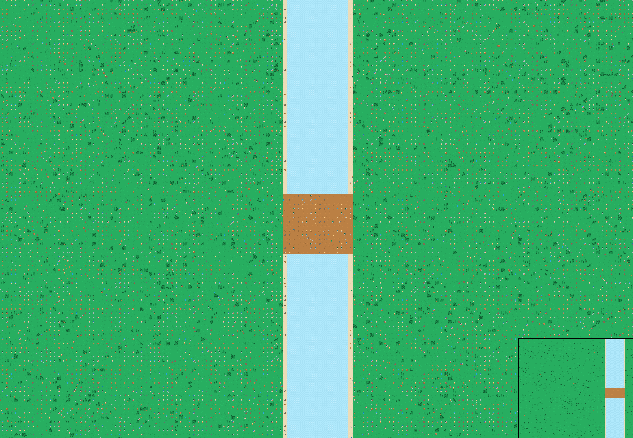
Thank you
Questions?

